Slide 1




Triage Toolkit for Children’s Cancer Services
3rd Edition 2026
Review date by Nov 2030
Training presentation
This presentation supports both initial and refresher training

Slide 2
This presentation will cover….
What the Triage Toolkit is?
  Purpose of the Toolkit
  Aim of the toolkit
  Background
  Changes / updates in version 3
How to use the toolkit
How to implement the toolkit in practice
Competency
  Scenarios
  Competency document

Slide 3
What is the Toolkit?
The Toolkit was developed as a guideline for the provision of triage assessment for children and young people
  Includes adolescents treated within Children’s Cancer Services. If adolescents are treated in adult or Teenage & Young Adult units, they are included in the Adult UKONs 24-Hr Triage Tool.
It has designed to be used by Triage Toolkit trained members of staff who operate 24-hour advice lines or conduct face to face triage assessments.
  Other options include face-to-face assessment: e.g. Community Nurse home visits, children presenting unannounced to wards or to clinic unwell if they are in a queue.
It is suitable for the malignant haematology and oncology patient groups, who are being treated by UK Children’s Cancer Services and:
  Have received or are receiving SACT treatment
  Have received or are receiving other anti-cancer treatment
  May be suffering from disease or treatment related immunosuppression.
It is endorsed by Cancer and Leukaemia Group (CCLG), UK Oncology Nursing Society (UKONS) and Young Lives vs Cancer
Notes:
Face to face triage includes Children’s Community Nurses (doing assessments in the home) or if a child was to present unwell at POSCU or PTC oncology clinic or as a walk in on the/a ward
Anti cancer treatments = immunotherapy, radiotherapy and haematopoietic stem cell or bone marrow transplant
Treatment related immunosuppression (i.e. corticosteroids)
The toolkit has not been validated with non-malignant oncology patients’. Trusts must make their own governance decisions on its use with this group. We are aware that some trusts use it for this group.
The toolkit must be used in conjunction to practitioners clinical judgment and professional cod of conduct.

Slide 4
What is the Toolkit?
The toolkit provides guidance and support to the trained practitioner in all stages of the triage process and can be adopted as standard practice. It offers a robust risk assessment tool which covers –
  Contact
  Record of reported symptoms
  Assessment of the problem
  Appropriate action
The triage tool and log sheet means that you have
  A simple but reliable system
  Safe and understandable guidance for the practitioner and caller
  High quality communication & record keeping
  Competency based training and assessment for practitioners
  Standards that can be used as auditing purposes
Notes:
It is a risk assessment tool which means that it does not address patient management post admission, nor does it contain admission pathways. It does, however, support recommendations for acute assessment by the practitioner who has carried out the triage.

Slide 5
Background
The original working group, in 2016, recognised a lack of relevant guidelines and training for practitioners providing telephone assessment and clinical advice
  A paediatric tool was adapted from the UKONS 24Hr Triage Tool (adult)
  Positive evaluation
    systematic approach,
    less reliant on variable individual experience and knowledge,
    Robust method of documentation and record keeping,
    No Serious Incidents (SI) or adverse events when Toolkit used as intended
This version is the third, as part of a scheduled review, with a previous review in 2020. This aligns with UKONS 3rd review of their tool in 2024.
Reviews ensure that the tools remain fit for purpose as treatments advance.
It is essential that organisations ensure they are using the most up-to-date version.
Notes:
Background
United Kingdom Oncology Nursing Society (UKONS) Adult version developed in 2007/2009 Positively evaluated. Release 2010, now used widely in all areas of the UK and internationally
2nd Edition Nov 2016 and 3rd edition 2024 – these reviews were to check that tool was fit for purpose
No serious incidents or adverse events due to the use of Toolkit reported during the pilot or since release, when it was used as intended. However, there are reported incidents of disastrous outcomes in adults and paediatrics, when an individual practitioner did not follow the two amber = red and therefore must attend for review rule (we will cover this more later.)
All cases which were discussed by a Coroner or the national safety agency were in relation to misuse of the Tool or Trusts locally adapting without rationale or permission.

Slide 6
Background (cont)
The triage tool is based on the NCRI-CTCAE common toxicity criteria
  Grading symptoms facilitates more accurate assessment of the scale of the problem
  Good practice in symptom recording using a scale for treatment toxicity reporting and recording especially in clinical trial patients.
  Allows for a consistent robust triage and advice
    Particularly important across services (e.g. POSCUs and PTCs)
The Triage tool sets a standard for best practice
  Log sheets can be used to provide evidence of quality and safety for the organisation and the individual practitioners
  The log sheets may identify risks and poor practice – identifying education and training needs.
However, it is not a diagnostic tool. Diagnosis and treatment advice given must follow local agreed pathways, and national or local guidelines and be within the scope of the practitioner
  Can also be monitored by reviewing log sheets
Notes:
It is good practice to familiarise yourself with the CTCAE criteria (link above) as problems other than those listed can be captured in the “other” section of the log sheet.
CTCAE is internationally recognised, and if you are not already using it to grade symptoms in all of your patient records, it is something you should become more familiar with and consider doing. Apart from triage assessment it ensures consistent reporting of symptom data for patients in clinical trials.
Auditing the tool / log sheets regularly is a good way to monitor use and advice given (more on audit tool later in presentation)

Slide 7
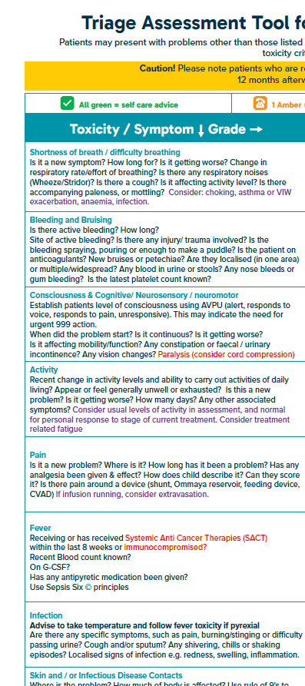
Changes / updates in version 3
The Triage assessment process remains unchanged
Alignment to UKONS v3 review (2025), resulted in changes to symptom / toxicity order. Now follows ABCDE approach, using the Resuscitation Council assessment approach used in all other NHS triage call centres (E.g 999 and 111)
Additional questions and prompts to improve clarity
Notes:
UKONS updated their 24-Hr triage toolkit in 2025 following their scheduled review process. We have aligned to a key change made by UKONS to re-order the symptom / toxicity list on the assessment poster to align with the Resuscitation council Airway, Breathing, Circulation, Disability, Environment (ABCDE) approach.
Pocket book recommendation which uses the ABCDE assessment approach. “Nursing & Health: Recognising the acutely ill child. Survival Guide.” E. Charnock, A Lee & A. Miller. ISBN: 978-0-273-76372-7

Slide 8
Changes / updates in version 3 continued
Considerations for immunotherapy treatment
  Toxicities
  Lengthened side effect profile
Considerations for targeted therapies
  New side effect profiles emerging
Training tools updated
  PowerPoint Training Presentation
  Learning scenarios
  UKONS eLearning modules can also be used to supplement learning
Notes:
We are in an era of new and emerging modes of treatment beyond the classic backbone of chemotherapy, radiotherapy, surgery.
The full list of modes of treatment may include chemotherapy, immunotherapy & bispecific antibodies, CAR-T and other gene therapies, Radiotherapy, Stem Cell Transplant, Surgery, Targeted therapies, Hormonal therapy, Antibody-drug conjugates (ADCs). It is reasonably important to accurately record on the Log Sheet what treatment the patient is on. Occasionally care-givers are unable to be specific and may just say they are ‘on-treatment’ of just give the name of the protocol they are on, without knowing whether the last treatment was chemotherapy or another type of systemic therapy. This can be noted on the Log Sheet under the medical history section.
The Log sheet has been updated to group these modes of treatment in a practical way for recording.
Systemic therapy (Chemo / Targeted / Immunotherapy)
CAR‑T / Cellular therapy
Post stem cell transplant
Radiotherapy
Surgery
None
There is a supplementary question about whether the patient has ever received previous immunotherapy, because the evidence is now showing that immunotherapy side effects and toxicities can emerge during treatment or months to years after treatment finishes. These side effects continue to appear even after treatment stops.
Be aware also, that targeted therapies may have a different side effect profile from the chemo side effects you are used to seeing. These drugs produce a characteristic pattern of “flu‑like + skin + GI” effects. You should stay up-to-date with common side effects of newer agents. These side effects usually stop after treatment stops. We are still learning about whether some targeted therapies show symptoms in a longer timeframe so remain mindful of the possibility.

Slide 9
The Triage Toolkit?
A risk assessment tool using a RAG
(RED, AMBER, GREEN) scoring system.
Developed for use by all members of staff who may be required to operate 24-hour telephone advice lines or conduct face-to-face triage for children who:
  Have received or are receiving systemic anticancer therapy in children’s cancer services UK
  Have received any other type of anticancer treatment, including radiotherapy and surgery
  May be suffering from treatment related immunosuppression (i.e. corticosteroids)

Slide 10
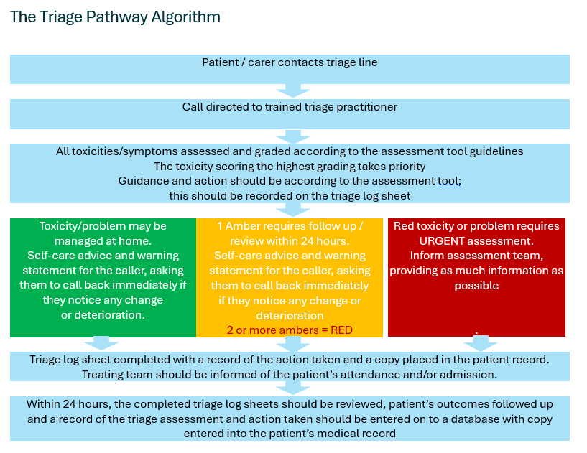
Notes:
Managing emergency symptoms
If it is identified that the patient’s problem is an acute emergency (Airway compromise, severe difficulty in breathing, collapse/unconsciousness/ severe bleeding or signs of sepsis), shorten assessment process and advise the caller to hang up and call 999. Complete the log sheet.
Non emergency red scores –
Educator note: This will be covered later in slides, but if asked at this point…. Even if red is scored early in assessment (e.g. for fever), the whole tool should be completed, even if patient will definitely need to come in to be reviewed, unless there is an obvious ABC emergency.
Log sheets should be kept accessible so that if there is a subsequent call – the previous log sheet can be reviewed

Slide 11
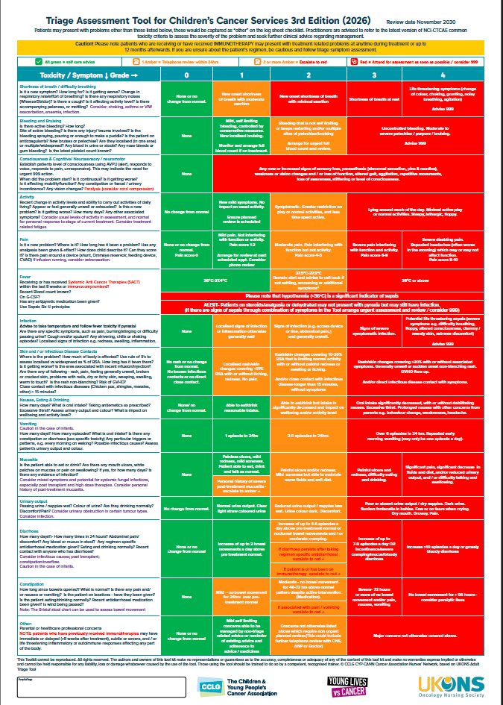
The triage assessment tool will:
Determine the patient’s “level
of risk”
Aid in identifying a potential emergency by using an ABC approach for initial questions
Prompt the practitioner with appropriate questions to ask, to gain information from the caller
Provide a reliable guide to toxicity / problem grading
Prioritise the level of urgency indicated by the presenting symptoms
Notes:
Keep in mind that the patient could be presenting with signs and symptoms of relapse or disease progression as well as the side effects of SACT, Surgery or radiotherapy.

Slide 12
The Scoring System
If no initial emergency (999) scenario - the call should proceed – any action is based on the triage practitioner’s grading of the presenting symptoms / toxicity following interview and data collection.
The RAG rating is used:
RED – any toxicity graded here takes priority and action must follow. Caller is advised that patient must attend for urgent assessment as rapidly as possible.
2 or more AMBER = RED – if a patient has two or more toxicities graded amber, they must be escalated to red action and the caller advised that the patient must attend for urgent assessment as soon as possible (same day or rapidly depending on symptoms).
AMBER – One toxicity in the amber area must be followed up within 24 hours and the caller should be instructed to call back if they continue to have concerns or the patient’s condition deteriorates. Scheduling a less urgent face to face assessment may also be considered.
GREEN – The caller must be instructed to call back if they continue to have concerns, if the patient’s condition deteriorates, or the patient’s symptoms worsen.
Notes:
In all circumstances, apart from situations requiring a 999 call, the full tool should be used and recorded.
This is particularly important for any scoring red – even if its obvious early on they will be coming for a review, as it gives a full understanding of the presenting problems and allows for a full SBAR handover to medical or receiving staff, or indicates urgent review is required. For example, many practitioners incorrectly stop the triage if a parent says the child has a fever of 38 at the beginning of the call, and often the parent tells the practitioner they are attending, putting pressure on the call handler not to continue. However, stopping at this point may miss additional severe problems that would prompt the call handler to advise calling 999. Children can and have arrested during the journey.
We are aware of two incident relating to the children’s version of the triage toolkit which were reviewed by NHS England Patient Safety Clinical Lead for Children & Young People and Human Factors, and the patient safety team. In both instances two ambers were recorded but the patient / care-giver was not advised to attend for rapid review. One was advised to stay at home with ‘safety netting advice’ ( we do not have details of what that was). In this instance the child died at home 4 hours after the call. In the other case the child had a very prolonged period in intensive care. Both of these incident occurred in the last 3 years and we would remind units of the need for refresher training and annual competency checks.

Slide 13
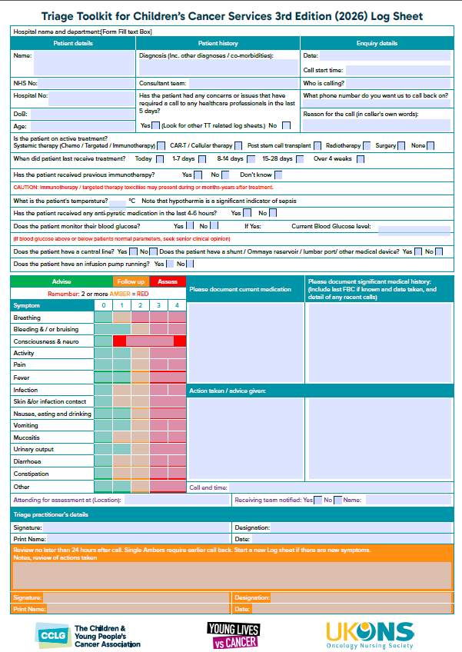
The Log Sheet
Allows for methodical and thorough data collection
  Useful data
  Accurate record
Completed for all triages and unscheduled visits (telephone or face to face)
  Facilitates audit of the service
The Triage boxes MUST all be marked accordingly.
Log sheet review should occur within 24 hours
Notes:
Log sheets should be kept accessible so that if there is a subsequent call – the previous log sheet can be reviewed. A local decision should be made at how best to store the log sheets securely but with accessibility to all who will receive calls 24/7.
Audit assists quality monitoring, improving patient care and experience, and facilitate services having data evidence for service planning. A new audit tool is offered with this V3 2026.

Slide 14
How to use the Tool
Environment
  Dedicated time in suitable area for telephone consultations
    Allows for appropriate attention to the call with no interruptions
    Facilitates real time recording on Log sheet
Proxy or patient
  Mostly will be parent or immediate care giver
  Can talk directly to older children and young people
Communication capability
  Assess the caller’s ability to communicate the current situation accurately, as well as understand the questions – consider if there are
    Language barriers
    Poor connectivity
    Level of distress
  Is the caller able to ask questions and clarify information if required
  Is there any reason why the guideline is not appropriate
If any doubt – arrange a face-to-face consultation and document decisions clearly
Notes:
Environment
Organisations should consider the location and provision of triage services. A suitable area and the dedicated time enables the practitioner to pay appropriate attention to the caller without being interrupted and facilitates real time recording of the interaction.
This ensures safe practice and aligns with similar organisational pathways such as 111 and 999.
This standard should be consistent and maintained 24/7.
Proxy or patient
In the majority of cases, the call will be received from the child or young person’s parent or immediate care giver.
Where it is considered appropriate to the triage process, the practitioner can talk directly to older children and young people; as it may enable a more accurate and complete assessment.
Communication capability
The practitioner needs to make a judgment on the caller’s ability to communicate so a full picture can be gained from the conversation. There may be a number of issues impacting the call.
Similarly, if the practitioner feels the caller doesn’t have the understanding or language to question or clarify – they should err on side of caution to see patient face to face.
It may be that the guideline isn’t appropriate to certain patient groups – this may require previous knowledge of the patient or family. This may be because there is personal circumstances regarding the patient or disease – these patients may need to have a face-to-face visit expediated (even if they don’t “score” to be reviewed). If there is deviation from advice in the toolkit, this must have excellent rationale, it must be discussed with a senior TT trained practitioner and the rationale clearly documented.
If there is any doubt, then a face-to-face assessment is recommended.

Slide 15
How to use the Tool (cont)
Some calls may be received that are not directly covered by the assessment tool. If the tool grading systems is helpful, they can be logged as ‘other’
  E.g.
    Medication query
    NGT problem
    CVAD problem - e.g. ambulatory infusion extravasation, split hickman line
    Patients on alternative pathways (e.g. Palliative care)
In these circumstances:
  Calls should be managed as per local policies or the specific pathway
  It may be appropriate to complete a full assessment to understand the context of the call and get a full picture of the child’s wellbeing.
  Some of these ‘other’ items may not require attendance for review but the toolkit facilitates good documentation of the enquiry and advice given.
  In some circumstances, additional teams (e.g. Symptom Control, Palliative Care, Hospice, POONS or CCN teams) need to be informed and can support.
  Documentation of decision making and clinical judgment is key and the Log Sheet should be used for recording and auditing.
Notes:
Centres or regions may have guidelines in place for what the tool is or isn’t used for. In all instances it is appropriate for seeking advice and assessment of on treatment side effects, toxicity or problems.
Some may also use it for patients receiving palliative care / EoL care, where others may just redirect calls to palliative care teams who have their own assessment tools.

Slide 16
How to use the Tool (cont)
Step 1 – Data collection
Perform a rapid initial assessment of the situation. Is this an emergency? Do you need to recommend phoning 999?
For all calls – record name and contact details of caller first, in case call is interrupted and you need to contact them back.
Is the caller able to understand and communicate? If there is any doubt in this, or a clear language barrier – arrange a face-to-face consultation.
Do you think the caller is able to provide accurate information and have a good understanding of the questions or instructions provided? If not, arrange a face-to-face consultation.
Ask questions in a logical sequence. Use the toolkit symptom assessment for the sequence and use the prompt questions to guide as appropriate.
Provide information slowly and thoughtfully. Allow the caller to comprehend what's being said and confirm understanding. Be conscious of anxiety and distress of caller and CYP.

Slide 17
How to use the Tool (cont)
Step 2 – Assessment of child / young person
What is the patient / carer’s initial concern, why are
they calling?
Initial assessment - using an ABC approach (first questions on Toolkit). If 999 required, advise to hang up and call emergency services. Record advice given on log sheet.
Continue assessment process – if RED score but not a 999 emergency – continue full assessment to gather more information and ensure no more urgent symptoms are missed – this will facilitate a high quality SBAR handover to the receiving team or appropriate escalation.
If situation changes and 999 required, stop and advise as such.
Notes:
It is important to listen and note the problem in caller’s own words. It is also important to utilise the tool systematically – so all symptoms are covered. Even if red score is obtained and the patient will need a face to face assessment, wherever possible continue the tool to gather as much information as possible to handover to the team that will be reviewing the CYP.

Slide 18
How to use the Tool (cont)
Step 3 – RAG grading assessment
If the patient / carer’s initial concern scores AMBER, record this on the Log Sheet and proceed with further assessment
Move methodically down the triage assessment tool, using the prompts to ask questions to grade the problem
For example, does the child have any shortness of breath or difficulty breathing?
If YES use the questions provided, such as “Is it affecting activity levels” to help you grade the problem. Note the grade on the Log sheet and continue assessment
If the patient’s symptoms score RED or another AMBER at any time, but there is no need for a 999 call, continue full assessment and then arrange for CYP to attend for a face-to-face consultation and review.
Notes:
The location of where the patient should attend for consultation and review will depend on regional pathways. This may be to a PTC or POSCU.

Slide 19
How to use the Tool (cont)
Step 4 – checking the Log Sheet
Have you fully completed the assessment?
Have you arranged attending for assessment for patients who have scored RED?
Have you arranged attending for assessment for patients who have scored more than one AMBER?
Have you fully assessed all the patients who have scored one AMBER,
is there a tick in all the other green boxes of the Log Sheet?
Have you fully assessed all the patients who have scored GREEN,
is there a tick in all the other green boxes of the Log Sheet?
Have you recorded the action taken and advice given?
Have you documented any decision you have taken or advice you have given that falls outside this guideline, and recorded the rationale for your actions?
Have you checked the caller understands, and agrees to follow, the advice given? If they are not in agreement to take the advised actions, record this.
Did the caller disclose any additional information that needs including, and communicating in the SBAR handover to receiving team (e.g. patient has Down Syndrome)
Notes:
A Log Sheet should be completed for all calls and may be used for unscheduled patient visits or assessing symptoms during home visits. This provides an accurate record of triage and decision-making and will support audit of the helpline service.
The data on the log sheet must be – complete, accurate, legible, concise, useful, traceable and auditable
Note all patients with Down Syndrome have higher frequency and more severe infections than the general population in non-cancer settings and more severe than other CYP on cancer treatment. They may also not have been able to communicate other compounding symptoms as easily and could have had more symptoms for longer that initially noted.
For Green/Amber CYPs ensure to say that family should call back if any concerns/changes and not wait for call back the following day.

Slide 20
How to use the Tool (cont)
Log Sheet Review -
The Hospital Designated Responsible Practitioner must review
all Log Sheets within 24 hours of the call as follows:
Original log sheet “Review of actions taken” should be completed and filed in the patients medical records
GREEN | Was this the correct advice? If not is any action / training needed now?
1 AMBER | Call the patient to assess if they are improving or not?
2 AMBER or RED | Follow the patient: were they admitted or not?
Admitted or Discharged | Admitted - find them and check management. Discharged - call to see if they are improving.
Use of Voicemail for CYP parent or carers for the follow up calls should be as per Trust Information Governance policy.
In all circumstances parents/carers should be reminded that ANY change in condition or concerns should be communicate by them calling NOT by waiting for a follow up phone call.
Notes:
It needs to be decided locally who the Designated Responsible Practitioner is and ensure this is role covered every day to allow for calls back within 24 hours. This is especially important for POONS / CCN teams – as it needs to be decided who is completing the follow up call (e.g. receiving PTC, POSCU or CCN team).
It needs to be recorded if the patient / care giver could not be contacted and spoken to directly within 24hrs. Most Trusts have a policy to attempt contact at least 3 times.
There needs to be a robust local system for record keeping with log sheets available for audit purposes.
The log sheets may be printed or in an electronic format, which may link with organisational systems.

Slide 21
How to use the Tool (cont)
Log Sheet Sharing
When the toolkit is introduced, or old editions replaced with current editions, it needs to be decided locally how this will occur and the local governance document updated.
Things to consider –
  Shared digital tools
  PDF Form fill & share
  Printed tool – scan & share
CCN / POONS – document & flag to local CNS team , PTC or POSCU as per regional arrangements
Discussion should be had with the research nursing team or clinical trials team on whether sharing of the Log Sheet would assist improved trial toxicity recording.
The coding team should be made aware of the Log sheets to code all calls.
Notes:
Forms part of governance process as decisions need to made and followed to include robust auditing.
It is recognised that CCN teams may support children with cancer from different PTCs and POSCUs. Discussions must be had with all to agree on communication and “handover / sharing” of Log sheets.

Slide 22
Auditing the tool
CCLG will be offering an audit tool as part of the 3rd Edition. This is optional and Trusts may use their own. However, audit is strongly advised.
Log sheets could be discussed in weekly / regular team meetings.
An auditing schedule would formalise the audit process.
Learning from the audits should feed into local training and service design.
Notes:
Log sheets and their review should be regularly audited to ensure the tool is being utilised correctly. Audits can help identify and inform training needs. Audit also enables review of the service – such as patterns of peak call times.. They facilitate workforce planning for peak call times and coding the advice line service for correct commissioning and income.

Slide 23
Introducing the tool
Clinical governance
The Triage toolkit must be agreed and approved locally.
There should be agreed assessment, communication and admission pathways, with agreed assessment areas and routes of entry for hospital care clearly defined and communicated.
There should be an identified practitioner for triage for each span of duty – with a clear handover to the next member of suitably trained and qualified staff.
The Triage Toolkit is a guideline and should be approved by the appropriate organisational governance group prior to implementation.
The governance responsibility for the provision of the service and the use of guidelines rests wholly with the service provider.

Slide 24
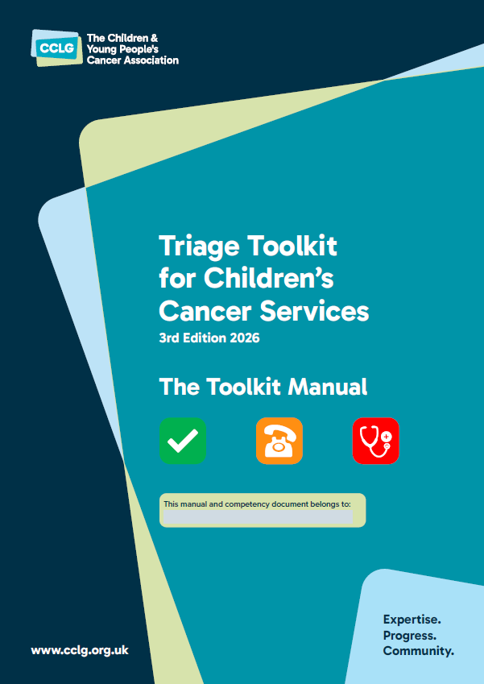
Training and competency
All staff must have read The Toolkit Manual
All staff using the Toolkit must receive training and assessment of competency.
Staff who are not trained to use the Toolkit should not provide telephone advice to parents or caregivers of children with cancer seeking advice about symptoms but refer immediately to a trained practitioner.

Slide 25
Training and Competence
Toolkit manual
Local face-to-face training
UKONS eLearning Modules are also available https://learninghub.nhs.uk/catalogue/UKONS-telephone-triage-training With units 1 and 3 being applicable to services covering any age group (paediatric, TYA or adult).
Local scenario practice (example scenarios are offered for educators to use)
Observed clinical practice
Competency assessment
Nurses should have achieved a minimum of children’s cancer foundation level training prior to becoming triage toolkit trained.
Medical staff should do the same above training if expected to provide triage advice by telephone.
Notes:
Optional additional online module using modules 1 and 3 of UKONS training.
The training process was trialled in the pilot process.
Wider healthcare team should be aware of the implementation of the triage process and the strict training and competency requirements. If they haven’t received the training – they should not be triaging the calls.
Foundation competencies as per NICE and children’s cancer service specs HSE Service Specification - CCLG supplementary guidance on nursing workforce education | CCLG - The Children & Young People's Cancer Association

Slide 26
Scenarios, role play and reflection
Training scenarios are available as an addition to this training pack.
Your local trainer may have alternative local scenarios.
For new users of taking triage calls and of the toolkit – role play may be a useful way of getting used to the skill of triage and using the tool
Reflection can be a useful way of understanding how to complete the Log sheet by reviewing filled in log sheets.
Notes:
Any local scenarios should be anonymised to protect patients’ identifiable information.

Slide 27
Using scenarios
Use a selection of the provided scenarios or from the local team or group experiences -
Role play giving information or taking the call and documenting on the Log Sheet
Support general discussion about the value and relevance of the triage process
Demonstrate practical application of the triage process in the clinical setting.
Discuss your thinking and rationale for decisions with your group

Slide 28
Guide to reviewing actual Log Sheets with reflective constructive critique in training sessions
Randomly select Log Sheets from your centre. Facilitators should anonymise staff who completed the log;
Discuss what you think has been done well
Discuss what you think could be improved
Did you disagree with any information – why?
Discuss your thinking and rationale for your critique with your group

Slide 29
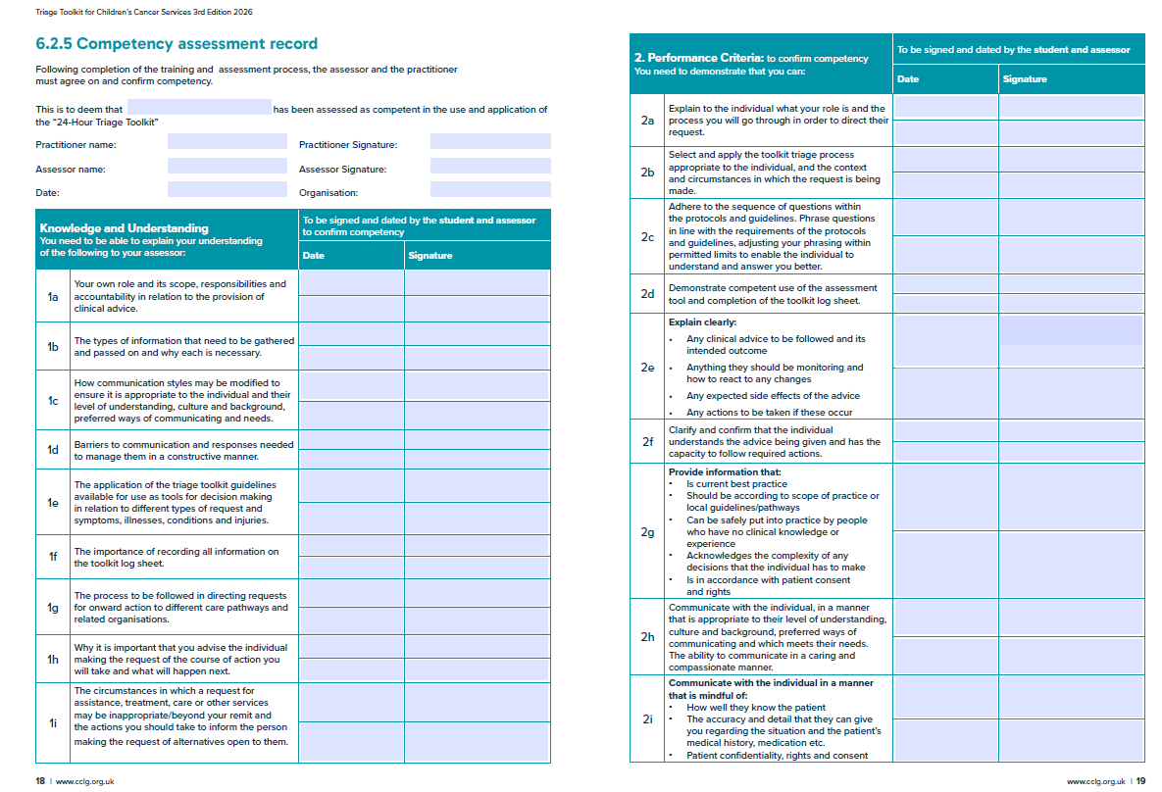
Competency document
The competency document available in the manual provides a systematic approach to competency on the Triage Toolkit and triage over the telephone
Managing emergency situations
Monitoring for and reporting changes in condition of the patient
Calming and reassuring the caller and CYP
The importance of:
  identifying capacity of the caller
  ensuring the caller is aware of calling back and when to
  Completing the assessment pathway
  Completing all documents fully
  Documenting decisions that fall outside the guideline and rationale

Slide 30
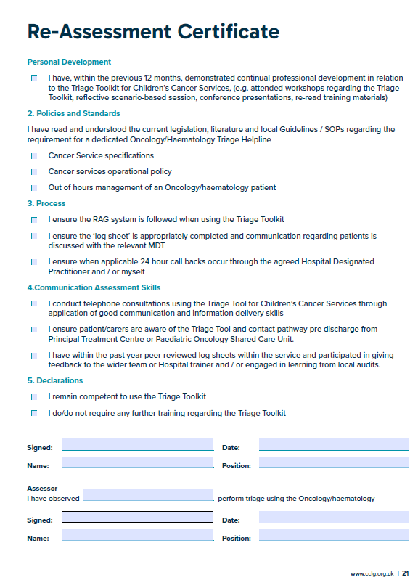
Maintaining triage competency
Named assessors should assess triage practitioners on a 12-monthly basis
Assessment should include:
  Observed practice
  Scenario assessment
  Discussion
There is a reassessment certificate available in the manual

Slide 31
In conclusion
The toolkit is a national standard
It improves patient safety and care
Provides robust and reliable assessment
Consistent quality of assessments, by using evidence-based validated assessment tool
Provides management advice depending on patient's level of risk
Identifies emergency situations and those who need urgent assessment in hospital
Identifies & reassures lower risk patients, reducing unnecessary attendance for review. Supports carers to stay at home with safety net.
Provides triage training and competency
Facilitates accurate records
Facilitates auditable practice

Slide 32
Any questions?
?

Slide 33
Thank you!
This training pack was developed by the CCLG Triage Toolkit Working Group (2025-2026)
The CCLG supports dissemination of the documents through hosting them for open access on their website. www.cclg.org.uk

